Slide 1
Programming in C#

Slide 2
Get Started with Our First C# Program
Write a program in any editor say Notepad.
Compile the program from developer command prompt.
Run the program:
First.cs
Assemblies
(MSIL)
.dll or .exe
Output
Compile
Execute

Slide 3


Assemblies
Building block of any .NET application.
A logical unit of code.
They form the fundamental unit of deployment.
Assembly physically exist as DLLs or EXEs.
Every Assembly file contains:
Information about itself called as Assembly Manifest.
Information about classes called as MetaData.

Slide 4
Getting Started with Visual Studio 2017
Getting familiar with project targeting and Visual Studio 2017
Write a ‘Hello World’ program.
Understand Console.WriteLine() string formatting
Understand Console.ReadLine() string parsing
Writing a simple program for arithmetic operations.
Understand Type Casting
Understand Boxing and UnBoxing
Understanding how to debug the program.

Slide 5
Output or Write Methods
The Write () Method
outputs one or more values to the screen without a new line character.
The WriteLine() Method
Always appends a new line character to the end of the string.
This means any subsequent output will start on a new line.

Slide 6
Input or Read Methods
ReadKey (returns a character):
Reads only one single character from the standard input stream.
Usually used when you're giving options to the user in the console to select from, such as select A, B or C. Another prominent example, Press Y or n to continue.
ReadLine (returns a string):
Reads only single line from the standard input stream.
As an example, it can be used to ask the user enter their name or age.
Read (returns an int):
Reads only one single character from the standard input stream.
Similar to ReadKey except that it returns an integer.

Slide 7
Data Types
Signed Integrals: sbyte, short, int, long
Unsigned Integrals: byte, ushort, uint, ulong
Characters: char, string
Floating Points: float, double
Boolean: bool
Enum Types
Struct Types
Nullable Value Types
Note: Ranges → https://docs.microsoft.com/en-us/cpp/cpp/data-type-ranges?view=vs-2017

Slide 8
Control Structures
Unconditional Statements
Goto
Continue
Break
Return
Conditional Statements
If
If Else
Else If ladder
Switch Case Default
Iterative Statements
For
While
Do While
Foreach

Slide 9
Assignment:
Write a C# program which takes current meter reading (CMR), previous meter reading (PMR) and type of connections as input and displays the bill amount.
Domestic Consumers:
0-200 units: Rs. 5 per unit
201-300: Rs. 7.20 per unit
301-400: Rs. 8.50 per unit
401-800: Rs. 9 per unit
Above 800 units: Rs. 9.50 per unit
Non-Domestic/Commercial:
0-100 units: Rs. 7.50 per unit
101-300: Rs. 8.90 per unit
301-500: Rs. 9.40 per unit
Above 500 units: Rs. 10 per unit

Slide 10
Object Oriented Programming

Slide 11
Object Oriented Programming
Object Oriented Programming (OOP) is a programming model.
Everything in OOPS placed together works as a self-contained object.
The key feature of OOPS is data security.
OOPS components are:
Classes
Objects
Encapsulation
Abstraction
Inheritance
Polymorphism

Slide 12
Classes and Objects

Slide 13
Classes
Class is a blueprint of an Object.
It is an collection of data members and member functions.
A class defines certain properties, fields, events, method etc.
A class defines the kinds of data and the functionality their objects will have.
A class enables you to create your own custom types.
It allows us to group together variables of other types, methods and events.

Slide 14
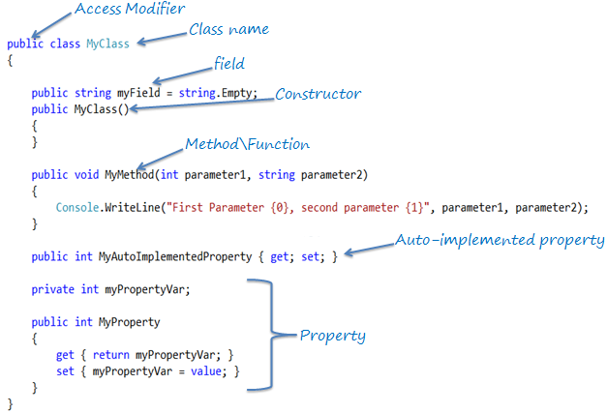

Slide 15
Objects
Any real time entity is known as an Object.
Every object consist of state and behavior.
States are called properties.
Behaviors are called methods.
It is an representor or instance of an object.

Slide 16
Encapsulation and Abstraction

Slide 17
Encapsulation
This binds the member function and data member into a single class.
This also allows for abstraction.
Within OOP, encapsulation can be achieved through creating classes.
Those classes then display public methods and properties.
Example,
Encapsulation is like an enclosing in a capsule, that is enclosing the related operation and data related to an object into that object.

Slide 18
Abstraction
Abstraction is important because it can hide unnecessary details from reference objects.
It is also necessary for the construction of programs.
Therefore, data abstraction is often used for managing large and complex programs.
Abstraction can be achieved by using Access Modifiers.

Slide 19
Access Modifiers
Access modifiers are applied on the declaration of the class and its members.
They define the accessibility of the class and its members.
Modifier | Description
public | There are no restrictions on accessing public members.
private | Access is limited to within the class definition. This is the default access modifier type if none is formally specified
protected | Access is limited to within the class definition and in inherited classes.
internal | Access is limited exclusively to classes defined within the current project assembly
protected internal | Access is limited to the current assembly and types derived from the containing class. All members in current project and all members in inherited classes.

Slide 20
Constructors

Slide 21
Constructors
Constructor is a special method, having the same name as the class/struct.
When an object of class or struct is created, its constructor is called.
They usually used to initialize the data members of the new object.
It won’t have any return type.
There are different types of constructors:
Default Constructor
Parameterized Constructor
Copy Constructor
Static Constructor and
Private Constructor

Slide 22
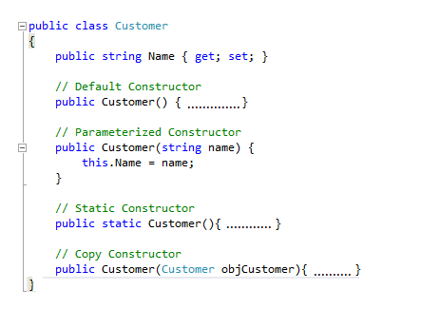

Slide 23
Default Constructor
Default constructor is automatically generated by the compiler in the absence of any programmer-defined constructors, and it don't have any parameter.
Many languages like C++, compiler don't generate any default constructor but user has to add one without any parameter.
Even in C# we can add a default constructor, in that case compiler will not generate any.

Slide 24
Parameterized Constructor
A parameterized constructor can have one or more parameters.
A class can have more than one paramerized constructors.
More than parameterized constructor should defer by function signatures as:
Number of parameters
Type of Parameters
Sequence of Parameters

Slide 25
Copy Constructor
A constructor accepting same type of object as parameter is Copy Constructor.
A class cannot have only copy constructor.
It need at least one more constructor to create the object.

Slide 26
Static Constructor
A static constructor is used to initialize the static member data.
It is used to perform some action only once in the beginning.
It is called implicitly before the first instance is created or any static members are referenced.
A static constructor does not take access modifiers or have parameters.
A class can only one static constructor
A class can have both instance and static construction in a single class
A static constructor cannot be called directly.

Slide 27
Private Constructor
In some cases we create a class which only have static members.
So, creating instance of this class is useless.
To prevent to create instance of class we use the private constructors.

Slide 28
Inheritance

Slide 29
Inheritance
In C#, Inheritance is used to inherit the properties from one class into class.
In C# inheritance, the class whose members are inherited is called base class.
In C#, a class can inherit one class at a time.
The class that inherits the members is called a derived class.
The inheritance helps in:
Reusability of Code
Reduce Time and Effort

Slide 30
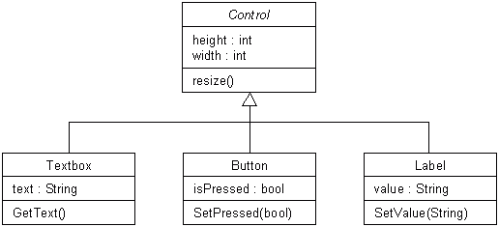
Inheritance Example

Slide 31
Types of Inheritance
OOPs support the six different types of inheritance as given below :
Single inheritance
Multi-level inheritance
Multiple inheritance
Multipath inheritance
Hierarchical Inheritance
Hybrid Inheritance

Slide 32
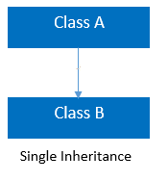
Single Inheritance
In this inheritance, a derived class is created from a single base class.

Slide 33
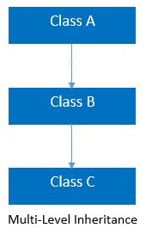
Multi-level Inheritance
In this inheritance, a derived class is created from another derived class.

Slide 34
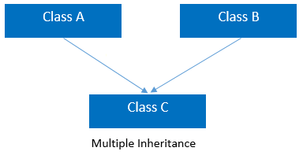
Multiple inheritance
In this inheritance, a derived class is created from more than one base class.
This inheritance is not supported by .NET and Java Language.

Slide 35
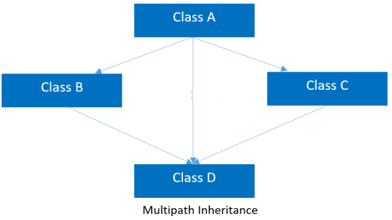
Multipath inheritance
In this inheritance, a derived class is created from another derived classes and the same base class of another derived classes.
This inheritance is not supported by .NET and Java Language.

Slide 36
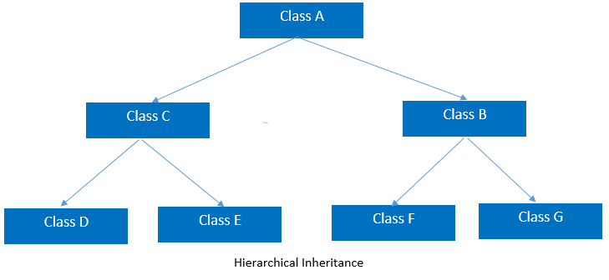
Hierarchical Inheritance
In this inheritance, more than one derived classes are created from single base class and further child classes act as parent classes for more than one child classes.

Slide 37
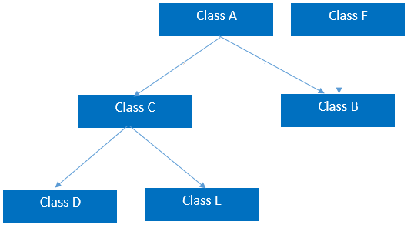
Hybrid Inheritance
This is combination of more than one inheritance.
Hence, it may be a combination of
Multilevel and Multiple inheritance or
Hierarchical and Multilevel inheritance or
Hierarchical and Multipath inheritance or
Hierarchical, Multilevel and Multiple inheritance.
This inheritance is not supported by .NET and Java Language.

Slide 38
Polymorphism

Slide 39
Polymorphism
Polymorphism is a feature of object-oriented programming.
Polymorphism means one name, many forms.
One function behaves in different forms.
In other words, "Many forms of a single object is called Polymorphism."
It allows you to invoke methods of a derived class during runtime.
It provides the different implementation of methods with the same name.

Slide 40
Types of Polymorphism
There are basically the following two types of polymorphism in C#:
Static / Compile Time Polymorphism.
Method Overloading
Constructor Overloading
Operator Overloading
Dynamic / Runtime Polymorphism.
Overriding using Virtual Methods
Overriding using Abstract Methods

Slide 41
Types of Polymorphism
Polymorphism
Static Polymorphism (Overloading)
Virtual Methods
Dynamic Polymorphism (Overriding)
Method Overloading
Operator Overloading
Abstract Methods

Slide 42
Overloading
Overloading is the mechanism to have more than one method with same name but with different signature (parameters).
A method can be overloaded on the basis of following properties
Have different number of parameter
Having same number of parameters but of different type
Having same number and type of parameters but in different orders
A method cannot be overloaded on the basis of
Different return type
Different access modifier
Normal and optional parameters

Slide 43
Overriding
Overriding can be done in derived class, an override method provides a new implementation of a method inherited from parent class.
To override a method in base (parent) class it must be
Virtual, abstract, override
We cannot override a base method which is in base class as
non-virtual and static
We cannot use the following modifiers to modify an override method in derived class
New, static, virtual, abstract

Slide 44
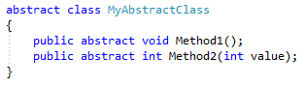
Abstract Methods
The purpose of an abstract class is to provide a common definition of base class.
Any class can be converted into abstract class by adding abstract modifier to it.
An abstract class cab be created by using abstract modifier

Slide 45
Abstract Methods
Common features of an abstract class:
An abstract class cannot be instantiated.
An abstract class can contain abstract as well as non-abstract methods.
An abstract method cannot have it implementation in abstract class itself.
An abstract class can never have a sealed modifier.
An abstract cannot be inherited from a class and multiple interfaces.
A property can also be abstract in an abstract class.
An abstract method can only be declared in an abstract class.
All derived classes must implement all the abstract methods in it.

Slide 46
Polymorphism: Points to be Noted:
Overloading can be done in same class.
Overriding can be done in parent and derived class.
Overloading in used when we need same method in same class with different parameters(using the different signature).
Overriding is used when we need to redefine a method that has already been defined in parent class (using the exact same signature).
Overloading is resolved at compile time.
Overriding is resolved at run time.

Slide 47
Interface

Slide 48
Interface
An Interface is a pure abstract class.
It is a reference type that contains only abstract methods. It only contains signature of its methods.
An interface has neither constructor nor fields.
It is also not permitted to have access modifier on its methods.
An interface can never be instantiated.
Its members are always implicitly public and abstract.
Its members cannot be declared as virtual or static.
We can implement multiple inheritance using Interface.

Slide 49
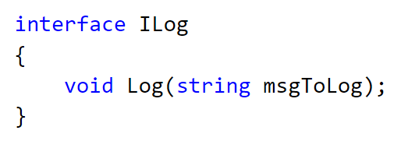
Interface
Interface Example:

Slide 50
Array in C#

Slide 51
Arrays
It is a user defined collection of homogenous data type elements.
We use index to access an element of an array.
When declaring an array, specify the type, name, dimensions and size.
In C# arrays are object and must be initialized, start with index zero (0),
C# supports:
Single-Dimensional Arrays,
Multidimensional Arrays (also call rectangular array) and
Array-of-Arrays (referred jagged arrays)

Slide 52
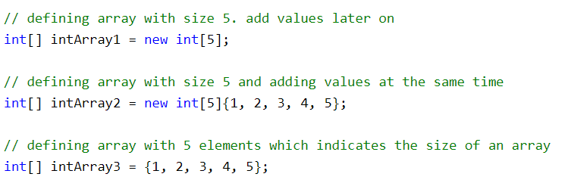
Arrays Initialization
An array can be declare using a type name followed by square brackets [].
An array can be declared and initialized at the same time using the new keyword.
The following example shows the way of initializing an array.

Slide 53
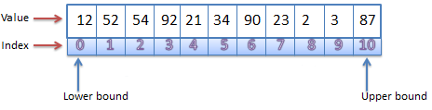
Single Dimensional Arrays
Arrays in C# are zero indexed.
An array with n elements is indexed from 0 to n-1.
Array elements can be of any type, including an array type as well.
Array types are reference types derived from the abstract base type Array.
We can use foreach iteration on all arrays in C#.

Slide 54
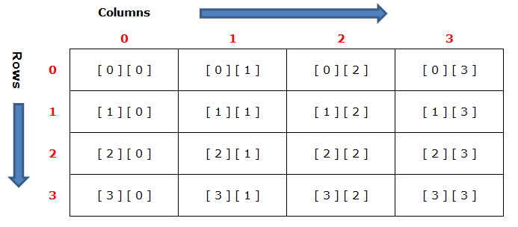
Multi-Dimensional Arrays
Two dimensional array is the simplest form of multi-dimensional array.
It can be thought as a table, which can contain number of rows and columns.

Slide 55
Jagged Arrays
It is also called array of array.
A jagged array is an array whose elements are also arrays.
The elements of a jagged array can be of different dimensions and sizes.
Before you can use jagged array, its elements must be initialized.
The element array can be of any length.

